Slide 1
Network Architecture
CS 4850 Lecture #2

Slide 2
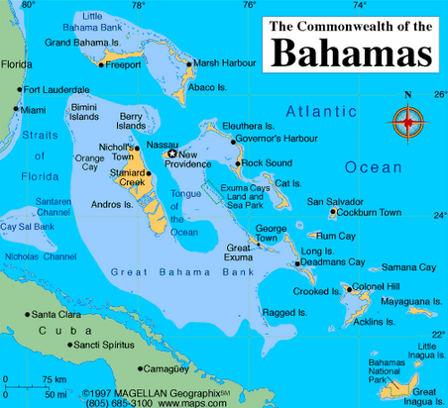
More About Me
1 of 8 kids
All kids names begin with “K”
Graduated from Central Methodist University
I Love Latin Dancing
Was President & CEO of a national non-profit: National Association of Graduation-Professional Students (NAGPS)

Slide 3
Network Architecture
What are some of the strategies used?
How are resources shared/distributed in a network?
Types of Communication
Network Problems/tolerances
Abstractions

Slide 4
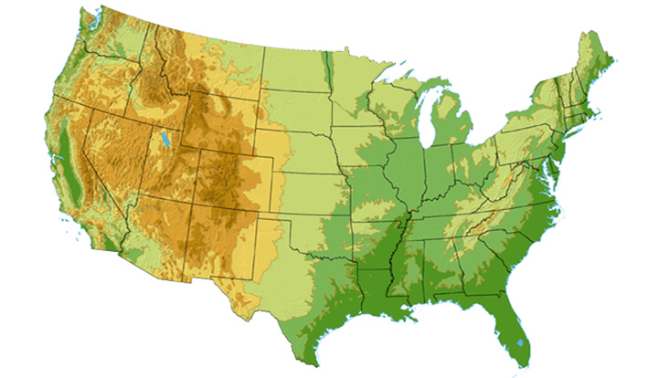

Sprint Network
Legend
DS3
OC3
OC12
OC48
45 Mbps
155 Mbps
622 Mbps
2.45 Gbps
Seattle
Click here for a closer look at the Sprint network in Washington state
Click here for a closer look at the Sprint network on the East Coast
Tacoma
Stockton
New York
Cheyenne
Chicago
Pennsauken
Relay
San Jose
Roachdale
Wash. DC
Kansas City
Click here for a closer look at the Sprint network in Northern
California
Anaheim
Atlanta
Fort Worth
Pearl City in Hawaii is
a future network location
Orlando
Notes:
DS3? Digital Signal 3 (DS3) (T-3 line), 45 Mbps
OC3? 155 Mbps

Slide 5
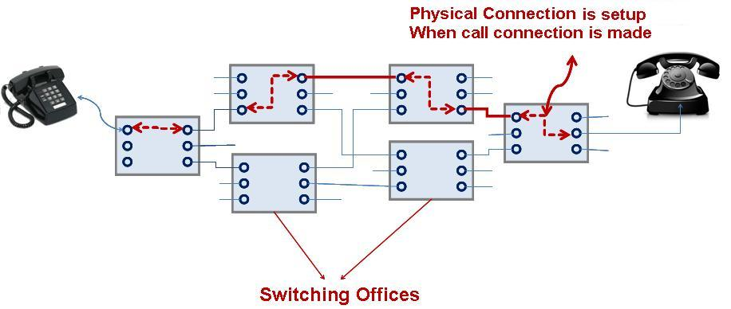
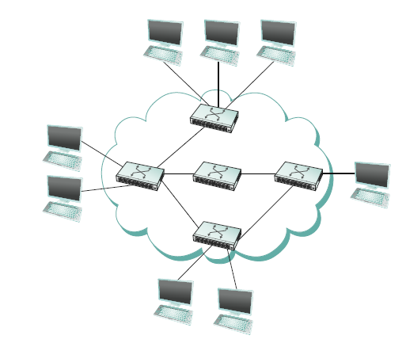
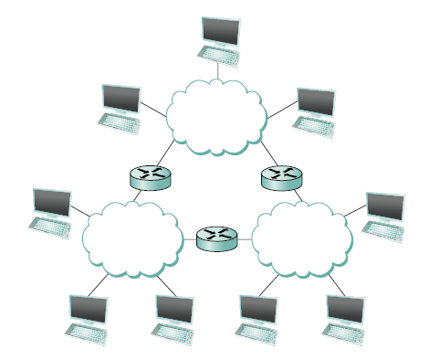
Strategies
Circuit switching: carry bit streams
original telephone network
Packet switching: store-and-forward messages
Internet
Notes:
1 network connected by switches
Multiple networks connected by routers
It can reasonably be argued that this idea of interconnecting widely differing networks was the fundamental innovation of the Internet and that the successful growth of the Internet to global size and billions of nodes was the result of some very good design decisions by the early Internet architects, which we will discuss later.

Slide 6
Addressing and Routing
Address: byte-string that identifies a node
usually unique
What other properties?
Routing: process of forwarding messages to the destination node based on its address
Types of addresses
unicast: node-specific
broadcast: all nodes on the network
multicast: some subset of nodes on the network
Notes:
Hierarchy!
An address is a byte string that identifies a node; that is, the network can use a node’s address to distinguish it from the other nodes connected to the network
The process of determining systematically how to forward messages toward the destination node based on its address is called routing.

Slide 7

How Do We Make System Resources to Many Hosts?

Slide 8
Multiplexing - A system resource shared by multiple users
Synchronous Time-Division Multiplexing (STDM)
Frequency-Division Multiplexing (FDM)
E.g., TV channels
Notes:
What might be the issues with these approaches?
Time slot of frequency may be idle
Number of flows are fixed
-At an intuitive level, multiplexing can be explained by analogy to a timesharing computer system, where a single physical processor is shared (multiplexed) among multiple jobs, each of which believes it has its own private processor. Similarly, data being sent by multiple users can be multiplexed over the physical links that make up a network.
-

Slide 9

Multiplexing: Possible Problems
Wasted resources when host has no data to send - STDM
Max number of flows must be fixed ahead of time - FDM
NOT PRACTICAL

Slide 10
Statistical Multiplexing
Used in Internet
On-demand time-division
Schedule link on a per-packet basis
What’s a packet?
Why is it necessary?
Packets from different sources interleaved on link
Buffer packets that are contending for the link
Buffer (queue) overflow is called congestion
■ ■ ■
Notes:
On demand
How does it ensure that each flow gets its time on the network?
What happens if one flow has more data to send than the other – Grocery Store analogy. Waiting in line
- defines an upper bound on the size of the block of data that each flow is permitted to transmit at a given time
What implications do packet switched networks place on the messages?
- limits the maximum size of packets, a host may not be able to send a complete message in one packet. source may need to fragment the message into several packets, with the receiver reassembling the packets back into the original message.

Slide 11
Communication
Besides host-to-host what other type of communication needs to occur on a network?

Slide 12
Inter-Process Communication
Turn host-to-host connectivity into process-to-process communication (to support common services).
Fill gap between what applications expect and what the underlying technology provides.
Notes:
It is more accurate to think of a network as providing the means for a set of application processes that are distributed over those computers to communicate.
-How to allow processes to communicate
developer’s perspective, the network needs to make his or her life easier.

Slide 13

IPC Abstractions
Request/Reply
distributed file systems
digital libraries (web)
Stream-Based
video: sequence of frames
1/4 NTSC = 352x240 pixels
(352 x 240 x 24)/8=247.5KB
30 fps = 7500KBps = 60Mbps
video applications
on-demand video
video conferencing
More demanding
What considerations would we need to make when designing a network for these types of process?
Notes:
What needs do the programs have
Intuitively, we view the network as providing logical channels over which application-level processes can communicate with each other; each channel provides the set of services required by that application. In
other words, just as we use a cloud to abstractly represent connectivity among a set of computers, we now think of a channel as connecting one process to another.
Should application programs have to implement all functions of the network?
What functionality do the channels need to have?
No delay?
In order
Eaves dropping?

Slide 14
What Goes Wrong in the Network?
Bit-level errors (electrical interference) 10000000000 vs 00000000000
Packet-level errors (congestion)
Link and node failures
Packets are delayed
Packets are deliver out-of-order
Third parties eavesdrop

Slide 15
Network Architecture
Networks a very complex. What can we do to decrease complexity to enhance ease of development?

Slide 16
Layering Architecture
Use abstractions to hide complexity
Abstraction naturally lead to layering
Alternative abstractions at each layer

Slide 17
What’s a Protocol?
network protocols:
machines rather than humans
all communication activity in Internet governed by protocols
human protocols:
“what’s the time?”
“I have a question”
introductions
… specific msgs sent
… specific actions taken when msgs received, or other events
protocols define format, order of msgs sent and received among network entities, and actions taken on msg transmission, receipt

Slide 18


What’s a Protocol?
a human protocol and a computer network protocol:
Hi
TCP connection
req.
Hi
TCP connection
reply.
Got the
time?
Get http://gaia.cs.umass.edu/index.htm
2:00
<file>
time

Slide 19
Protocols
Building blocks of a network architecture
Each protocol object has two different interfaces
service interface: operations on this protocol
peer-to-peer interface: messages exchanged with peer
Term “protocol” is overloaded
specification of peer-to-peer interface
module that implements this interface

Slide 20
Interfaces

Slide 21
Protocol Machinery
Protocol Graph
most peer-to-peer communication is indirect
peer-to-peer is direct only at hardware level
Host 1
Host 2
File
Digital
Video
File
Digital
Video
application
library
application
application
library
application
application
application

Slide 22
Machinery (cont)
Multiplexing and Demultiplexing (demux key)
Encapsulation (header/body)
Host
Host
Application
Application
Application
Application
program
program
program
program
Data
Data
RRP
RRP
RRP Data
RRP Data
HHP
HHP
HHP RRP Data

Slide 23
Internet Protocol Stack
application: supporting network applications
ftp, smtp, http
transport: host-host data transfer
tcp, udp
network: routing of datagrams from source to destination
ip, routing protocols
link: data transfer between neighboring network elements
ppp, ethernet
physical: bits “on the wire”
application
transport
network
link
physical

